Slide 2

Unit 15: Creating and Using Dynamic Actions
and Plug-ins

Slide 3
Lesson Objectives
After completing this lesson, you should be able to:
Describe Dynamic Actions
Create and use Dynamic Actions
Describe Plug-ins
Implement Plug-ins in your application
Notes:
Developers use dynamic actions to define complex client-side behavior declaratively without the need for JavaScript. In this lesson, you learn how to create and use dynamic actions in your application. This lesson also covers how to import and use plug-ins. You can find plug-in examples on the Oracle Application Express Plug-in Repository: https://apex.oracle.com/plugins and in the Sample Database Application.

Slide 4
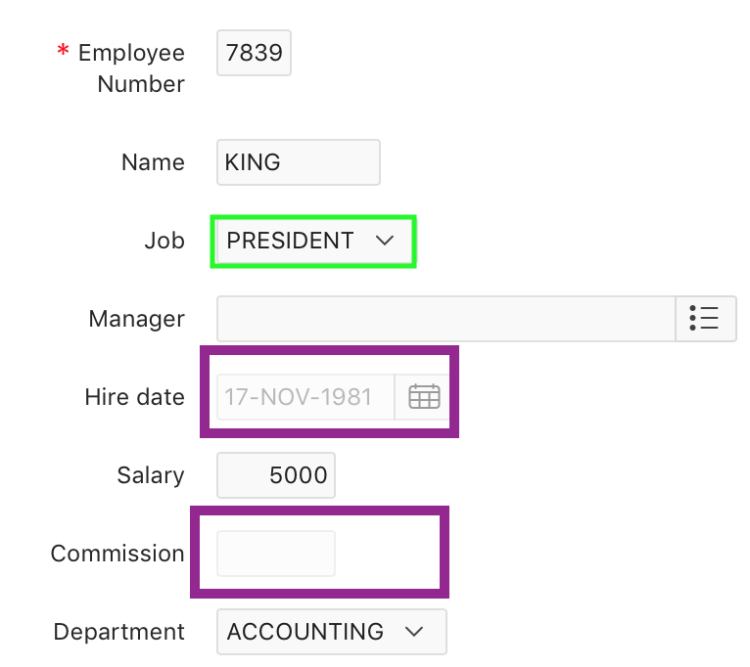
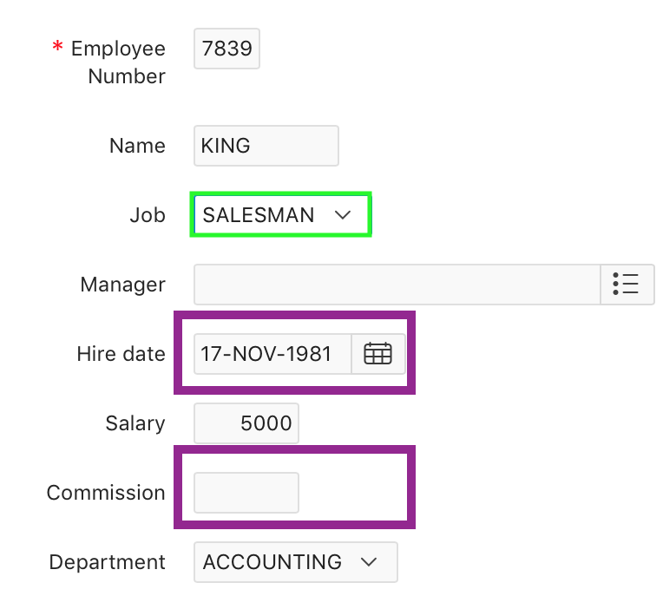
Understanding Dynamic Actions
Dynamic Action ensures that the Commission and Hire date fields are enabled only if the Job is SALESMAN
Notes:
Dynamic actions provide you a way to define complex client-side behavior declaratively without the need to know or code JavaScript or AJAX. Using the Dynamic Action Create wizard, you specify an action that is performed when a defined set of conditions occur. You can also specify which elements are affected by the action, and when and how they are affected.
When working with dynamic actions, you should be mindful of the fact that the more dynamic actions you add to a page, the greater your overall page size. This is because the dynamic action framework emits additional JavaScript and possibly AJAX code to the client for each dynamic action defined, which then also must be downloaded and executed by the framework in the client.
The slide example demonstrates how dynamic actions can be used to control multiple items and also that disabling items works for multiple item types. To achieve this, the form page contains a dynamic action called 'JOB EQUALS SALESMAN'. This fires whenever a different 'Job' is selected from the 'Job' select list and checks if the value is equal to 'SALESMAN'. If it is equal to 'SALESMAN' the 'Commission' and 'Hiredate' page items are enabled, otherwise they are disabled. It uses 2 native actions ('Enable' and 'Disable'). You learn how to create dynamic actions in the next few slides.

Slide 5
Implementing a Dynamic Action
Create or edit an item, interactive grid column, button, region, JavaScript Expression, or jQuery selector on a page
Create a dynamic action from the application page that invokes the action
Run your application to test the dynamic action.
Notes:
The process of implementing a dynamic action involves the following:
Create or edit an item, interactive grid column, button, region, JavaScript Expression, or jQuery selector on a page. This component is referenced within the dynamic action in defining when it fires.
Create a dynamic action from the application page that invokes the action.
Run your application to test the dynamic action.

Slide 6
Creating a Dynamic Action: Steps
View the page to contain the item in Page Designer. Click the Dynamic Actions tab in the left pane.
Under Dynamic Actions, right-click Events and select Create Dynamic Action.
In the Property Editor, edit the following Dynamic Action attributes:
Identification > Name, Execution Options> Sequence
When > Event , When > Selection Type
Client-side Condition > Type, Optionally select the condition you want to control the true and false action processing of the dynamic action
Define the action that to be performed if the event evaluates to True or False
Click Save.
Notes:
Creating a dynamic action involves specifying the following:
When the action happens (with optional conditions)
What action or actions are performed
What elements are affected by the action
The slide shows steps involved in creating a dynamic action. You can create a dynamic action in Page Designer by any of the
following ways:
Under Rendering, locate the item, right-click and select Create Dynamic Action
Click the Dynamic Actions tab in the left pane. Right-click Events and select Create Dynamic Action. You can also select an event type and then right-click to select Create Dynamic Action.

Slide 7
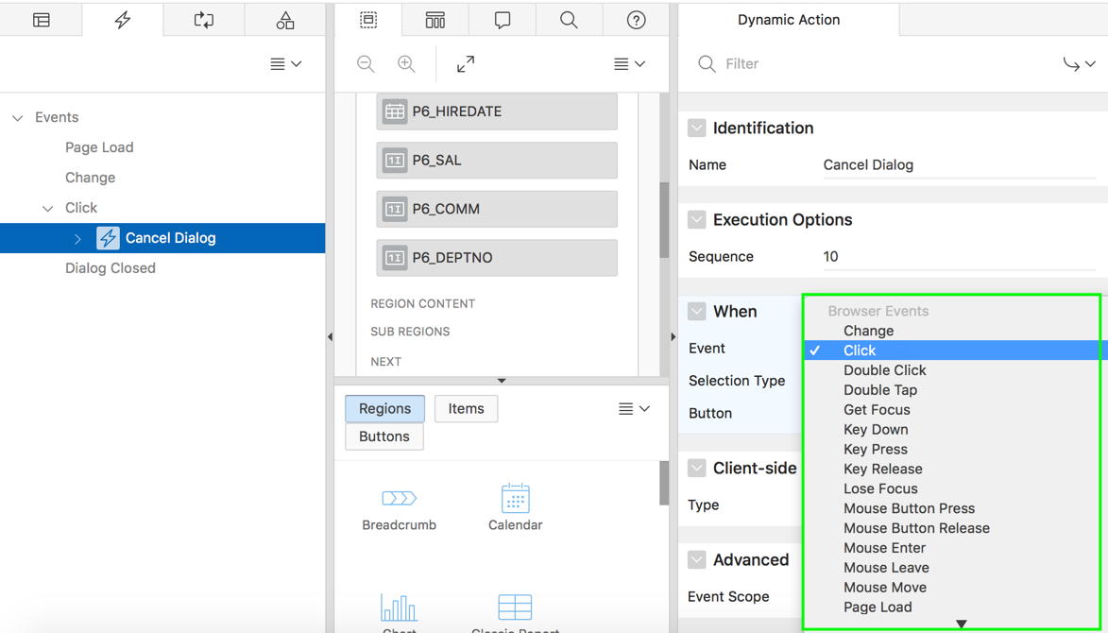
Understanding Dynamic Action Events
You can define dynamic actions to fire based on events that happen on the page.
Oracle Application Express includes four different categories of events:
Browser Events
Framework Events
Component Events
Custom Events
Notes:
When you create a dynamic action, you specify the event that causes the dynamic action to fire.
Events are categorized into the following types:
Browser Events: Standard browser events. For example, Change, Click, Double Click, Get Focus, and so on.
Framework Events: Framework events are triggered from within the Application Express framework. For example, After Refresh, Before Page Submit, and so on.
Component Events: Only available when there is a component available to your application that triggers a custom event. These events are triggered from either native components or plug-in components you have installed in your application.
Custom Event: Any custom event triggered from your application.
Note: The events displayed differ based on page's current User Interface type. If you wish to select an event that corresponds to a different type, then you have the option of selecting Show unsupported, which displays all events including those that do not correspond to the current type.
For information about specific events, please see the relevant section in the App Builder User's Guide.

Slide 8
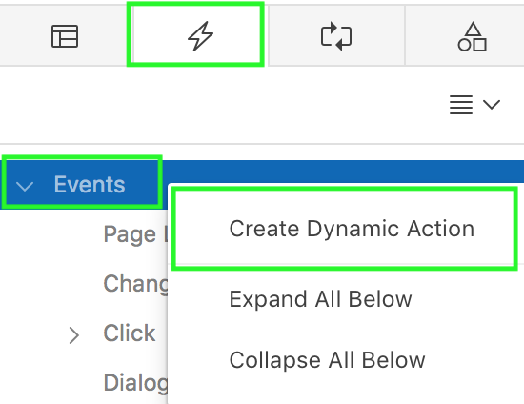
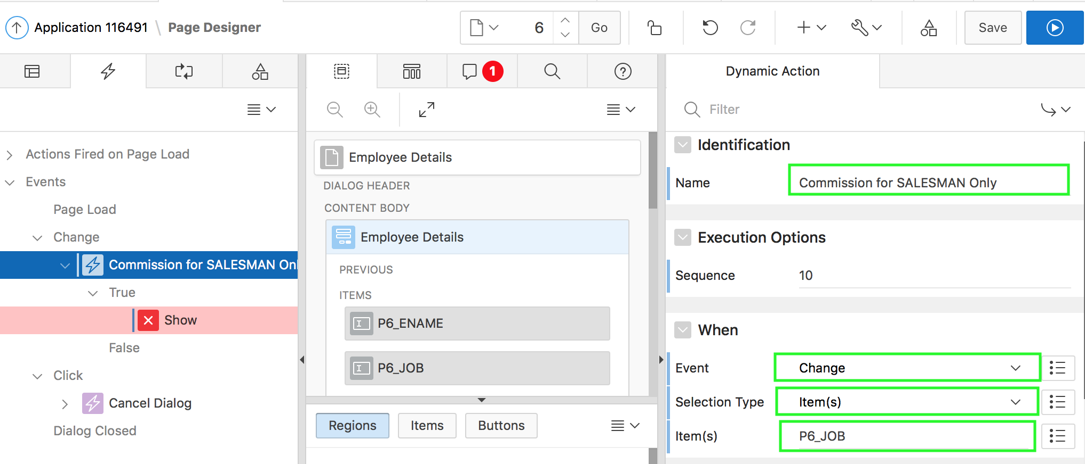
Enabling and Disabling Items: Steps
1
2
Notes:
The slide shows an example of a dynamic action to enable and disable items based on the value of an item. To create this dynamic action, navigate to the form page that contains the item for which you want to create a dynamic action. Perform the following steps:
View the page to contain the item in Page Designer. Click the Dynamic Actions tab in the left pane
First, create a dynamic action. To do this, Right-click Events and select Create Dynamic Action. A new dynamic action is
created. The Property Editor displays Dynamic Action attributes.
Specify the following Dynamic Action Attributes:
Name: Enter a name for the dynamic action. In the slide example, enter "Commission for SALESMAN Only"
Under When > Event: Specify the event that causes the dynamic action to fire. In the slide example, select Change.
For When > Selection Type: Select the type of page element or construct to be used to trigger the event. In the example, select Item(s)
For Item(s): Select P<n>_JOB

Slide 9
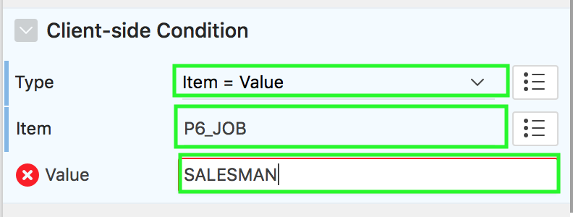
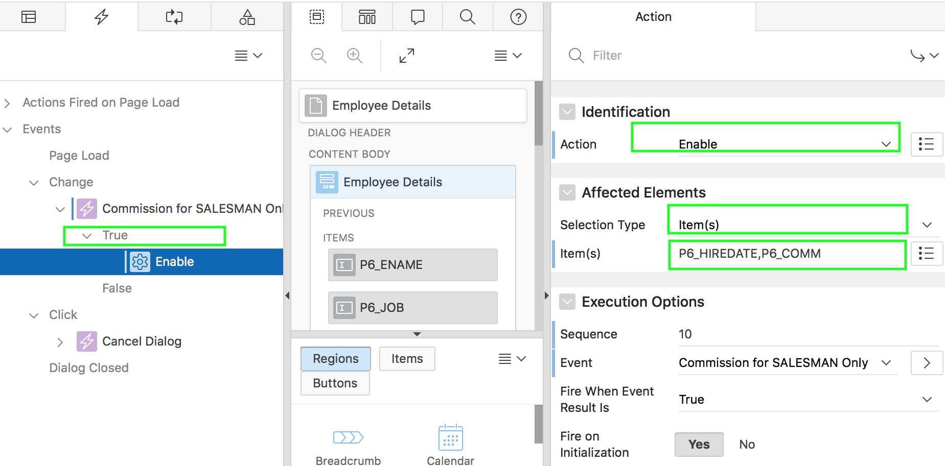
Enabling and Disabling Items: Steps
4
3
True action
Notes:
Now, specify the Client-side condition. In the slide example, for Type, select Item – Value. Select P<n>_JOB for Item and enter SALESMAN for Value.
Now, define the action that to be performed if the event evaluates to True or False.
Expand the Dynamic Action tree to view the True or False nodes. Under True or False, select the action. Edit the action in the
Property Editor. For True action, select the action that triggers when the condition is true. In the slide, select Enable. Under Affected
Elements, select Item)s) for Selection Type. Then, select P<n>_HIREDATE. P<n>COMM for Item(s).

Slide 10
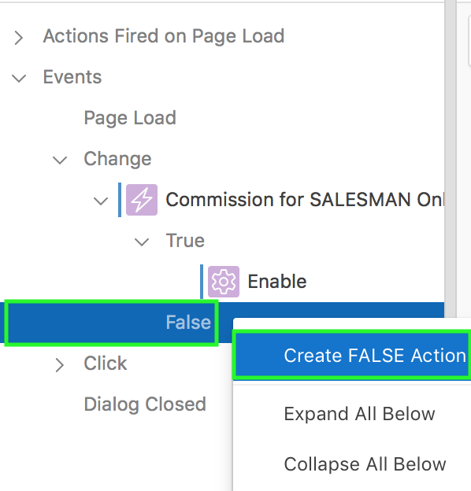
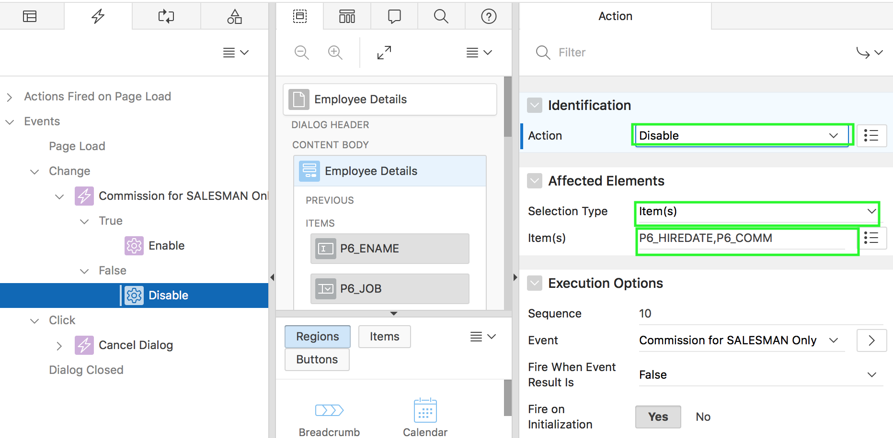
Enabling and Disabling Items: Steps
6
5
False action
Notes:
Now, create a false action. Right-click the False node and select Create FALSE Action.
In the Property Editor, For False action, select the action that triggers when the condition is false. In the slide, select Disable for Action. Under Affected Elements, select Item)s) for Selection Type. Then, select P<n>COMM, P<n>_HIREDATE for Item(s). Click Save. Then, click Save and Run Page.

Slide 11
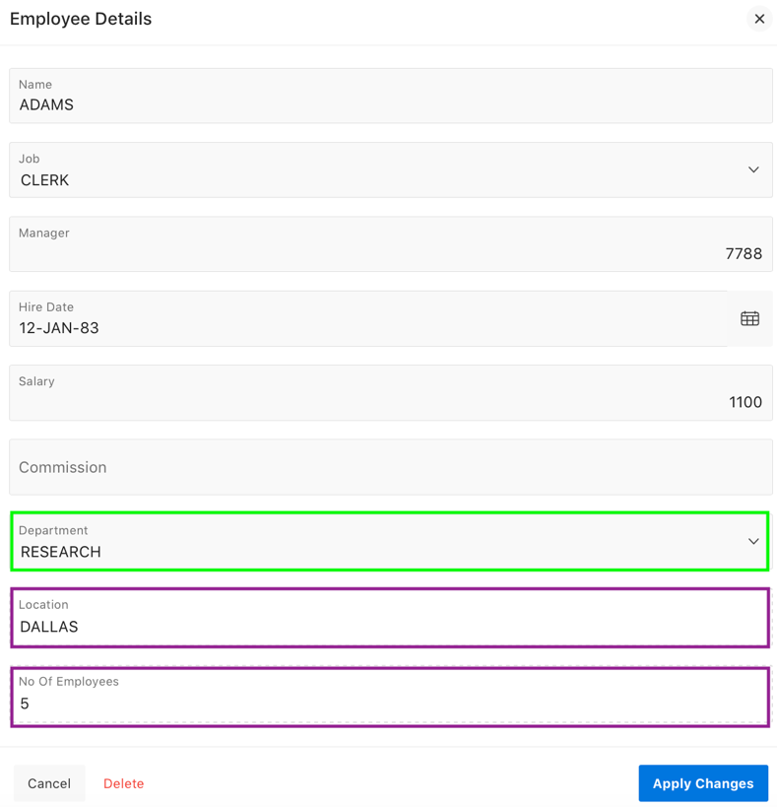
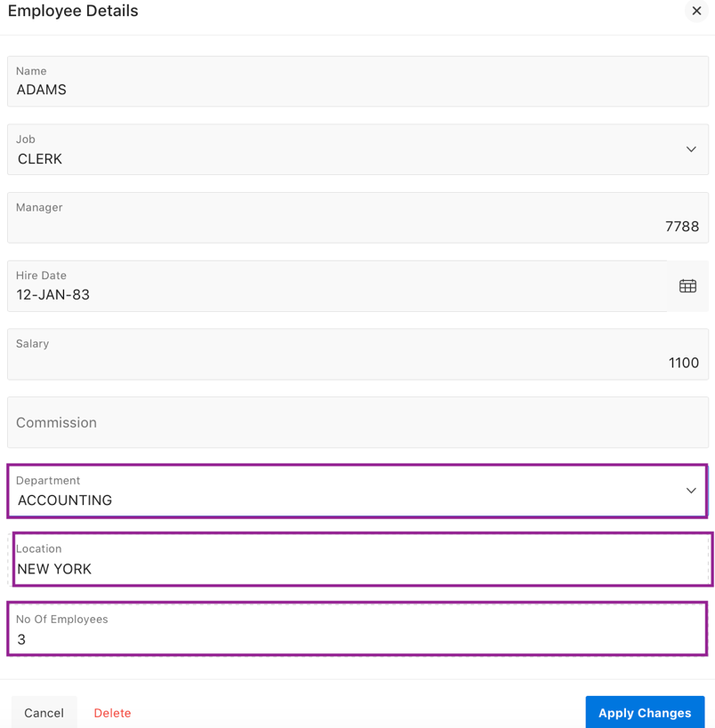
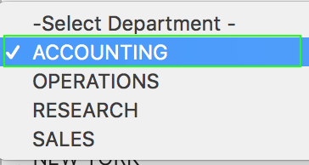
Setting the Value of Page Items: Set Value Example
Select a department
Location and Number of Employees information are retrieved and displayed for the selected department
Notes:
The slide example shows using a dynamic action called 'GET DEPT INFORMATION'. This fires whenever the 'Department' page item changes and invokes an AJAX call that retrieves the 'Location' and 'Number of Employees' information for the selected department from the database. It uses one native action ('Set Value' with a 'Set Type' of 'SQL Statement').
In the slide example, you select RESEARCH for Department and the Location (DALLAS) and No of Employees (6) for that
department are displayed. Similarly, when you select, ACCOUNTING for Department, the location and number of employees are
changed accordingly.

Slide 12
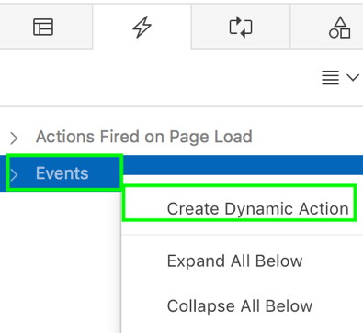
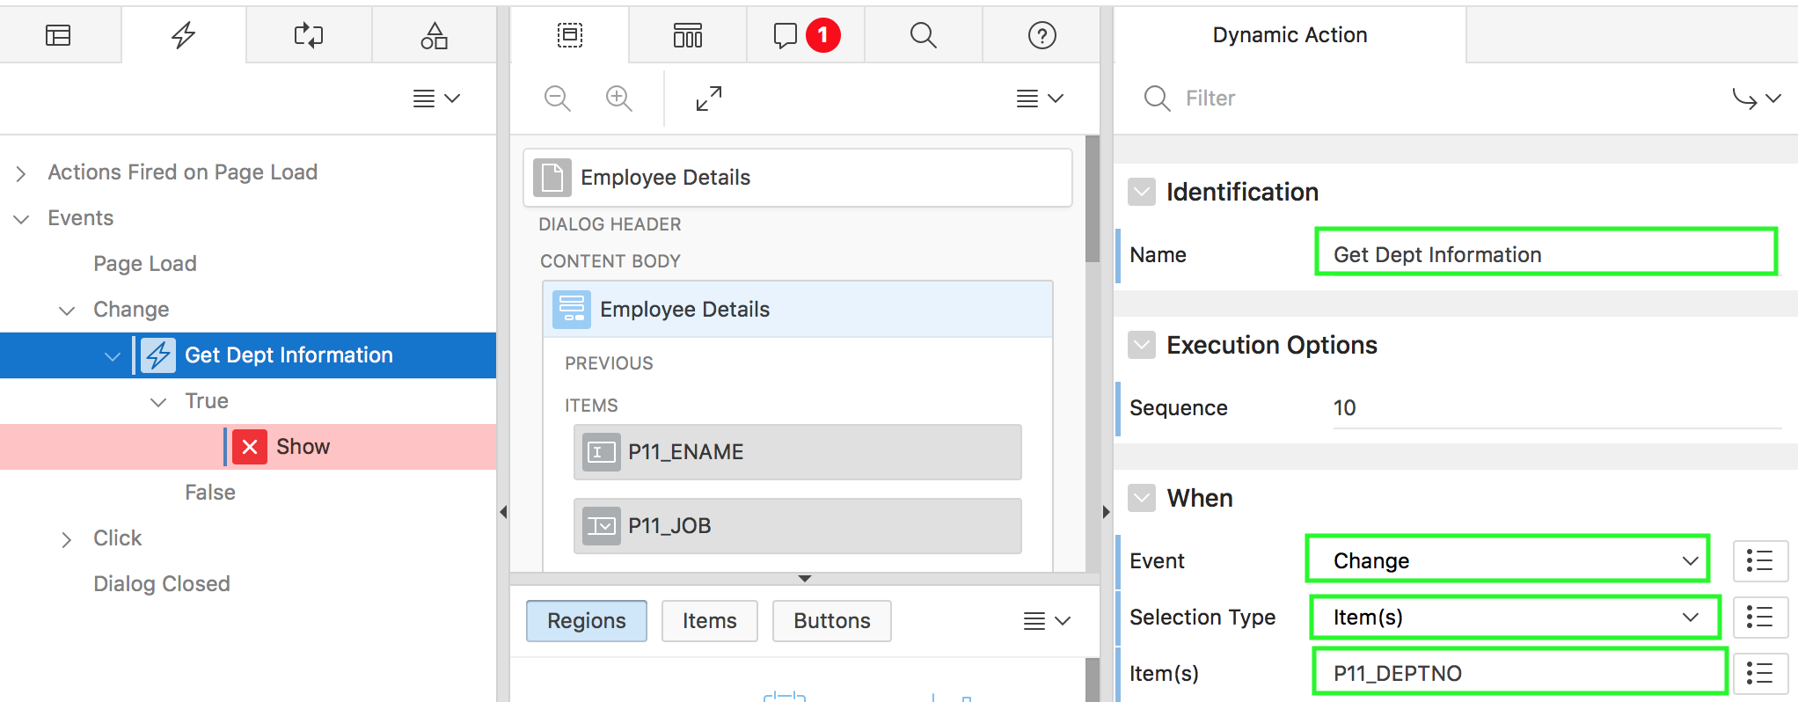
Setting the Value of Page Items: Steps
2
1
Notes:
The slide shows an example of a dynamic action to set the value of page items. To create this dynamic action, navigate to the form page that contains the item for which you want to create a dynamic action. Perform the following steps:
View the page to contain the item in Page Designer. Click the Dynamic Actions tab in the left pane
First, create a dynamic action. To do this, Right-click Events and select Create Dynamic Action. A new dynamic action is
created. The Property Editor displays Dynamic Action attributes.
Specify the following Dynamic Action Attributes:
Name: Enter a name for the dynamic action. In the slide example, enter Get Dept Information.
Under When > Event: Specify the event that causes the dynamic action to fire. In the slide example, select Change.
For When > Selection Type: Select the type of page element or construct to be used to trigger the event. In the example, select Item(s)
For Item(s): Select P<n>_DEPTNO
Now, define the action that to be performed if the event evaluates to True or False.

Slide 13
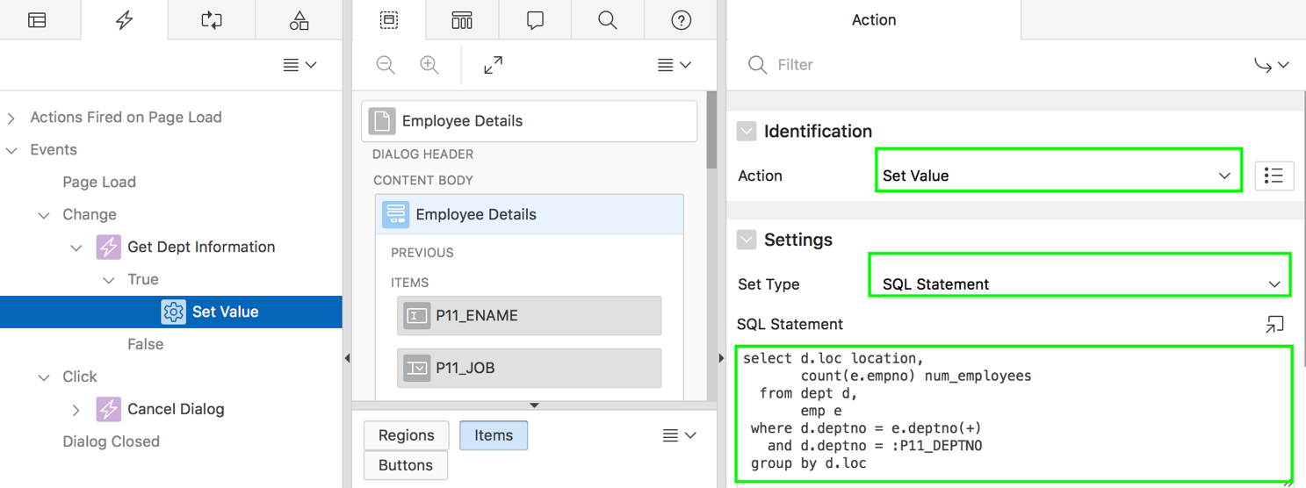
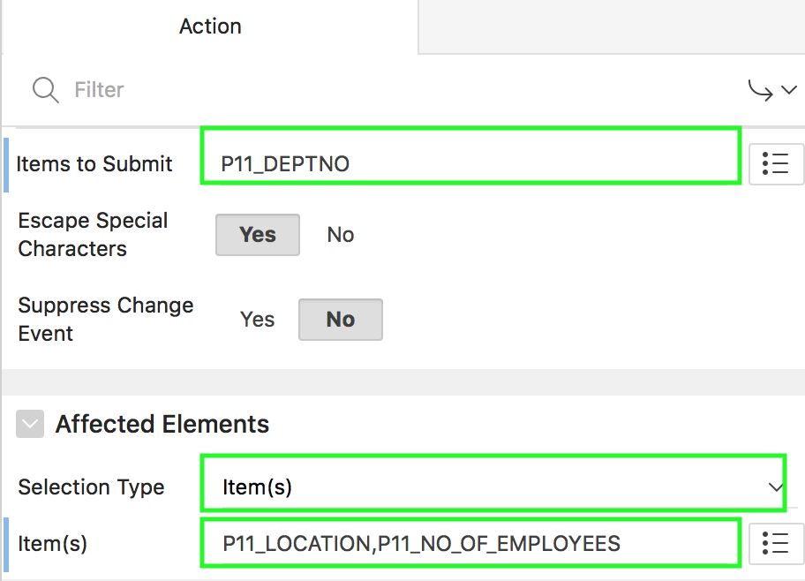
Setting the Value of Page Items: Steps
3
4
Only one native action used
Notes:
Expand the Dynamic Action tree to view the True or False nodes. Under True, select the action that triggers when the condition is true. Edit the action in the Property Editor. For True action, specify the following:
In the slide, select Set Value for Action.
Under Settings, select SQL Statement for Set Type. Then, enter the SQL statement. In the slide example, you enter the SQL to retrieve the location and the number of employees for the department selected.
For Items to Submit, select P<n>_DEPTNO. Under Affected Elements, select Item(s) for Selection Type. Then, select P<n>_LOCATION, P<n>_NO_OF_EMPLOYEES.
Click Save. Then, click Save and Run Page.

Slide 14
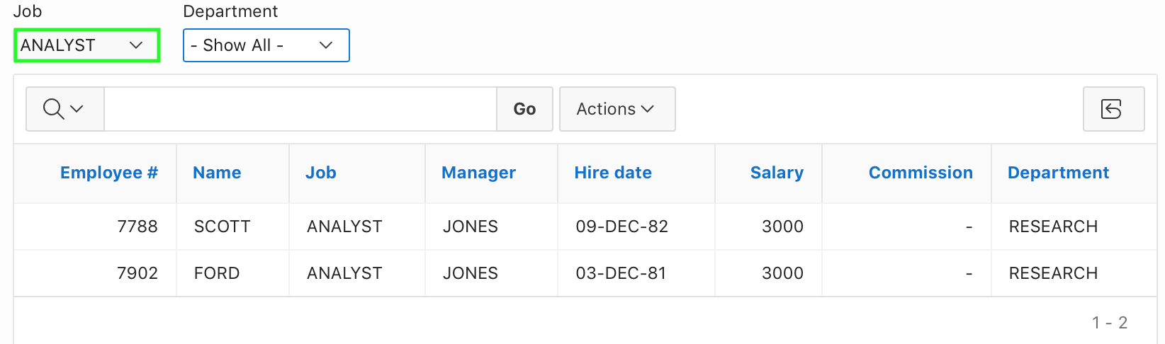
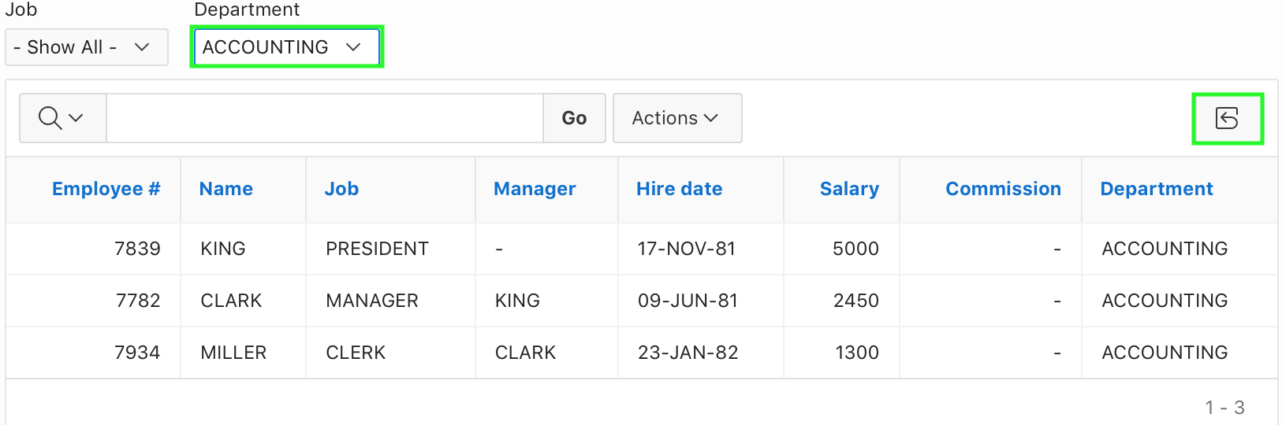
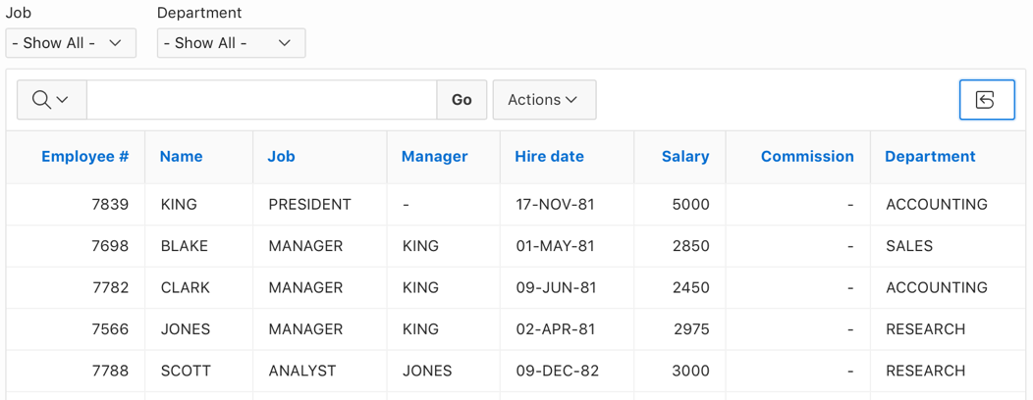
Filtering and Refreshing a Report: Example
Data is refreshed upon selecting a job or a department
Select lists are cleared and data is refreshed upon clicking the Reset button
Notes:
In the slide example, a page contains two dynamic actions, 'FILTER REFRESH' and 'RESET REPORT'.
'FILTER REFRESH' fires when either the 'Department' or 'Job' select list values are changed and refreshes the report via Ajax to show the newly scoped employees.
'RESET REPORT' fires when the 'Reset' button is pressed, which resets the report via Ajax, by clearing the select lists and refreshing the report.
'FILTER REFRESH' uses one native action ('Refresh'). 'RESET REPORT' uses two native actions ('Set Value' and 'Refresh').

Slide 15
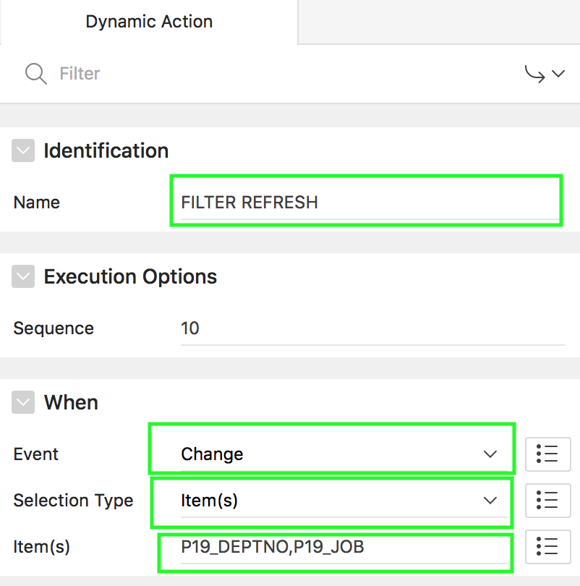
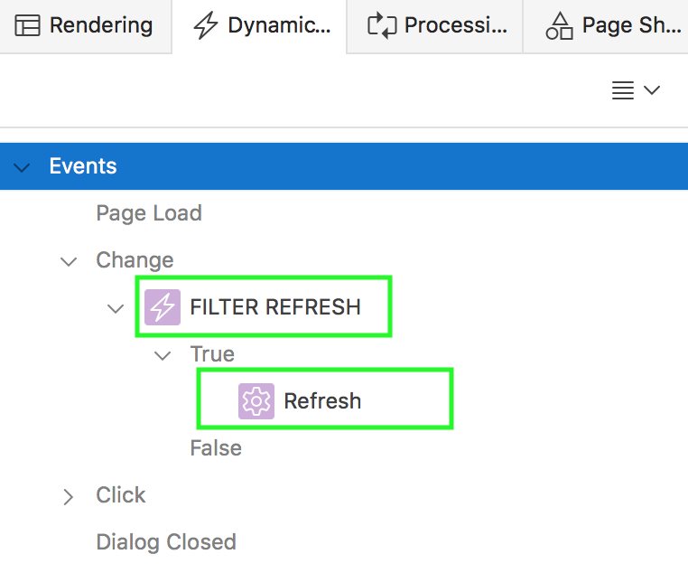
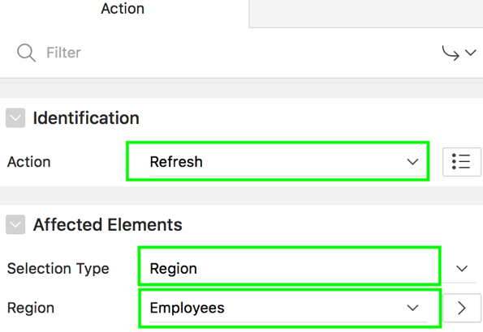
Filtering and Refreshing a Report: Steps
Dynamic Action: FILTER REFRESH
Action: Refresh
Notes:
To create the first dynamic action (Filter Refresh), perform the following steps:
View the page in Page Designer. Click the Dynamic Actions tab in the left pane
Right-click Events and select Create Dynamic Action. A new dynamic action is created. The Property Editor displays Dynamic Action attributes.
Specify the following Dynamic Action Attributes:
Name: Enter a name for the dynamic action. In the slide example, enter Filter Refresh.
Under When > Event: Specify the event that causes the dynamic action to fire. In the slide example, select Change.
For When > Selection Type: Select the type of page element or construct to be used to trigger the event. In the example, select Item(s)
For Item(s): Select P<n>_DEPTNO,P<n>_JOB (First select P<n>_DEPTNO, then select P<n>_JOB)
Expand the Dynamic Action tree to view the True or False nodes. Under True, select the action that triggers when the condition is true. Edit the action in the Property Editor. For True action, specify the following:
In the slide, select Refresh.
Under Affected Elements, select Region for Selection Type. Then, select the report region name. For example, in the slide, select Employees.

Slide 16
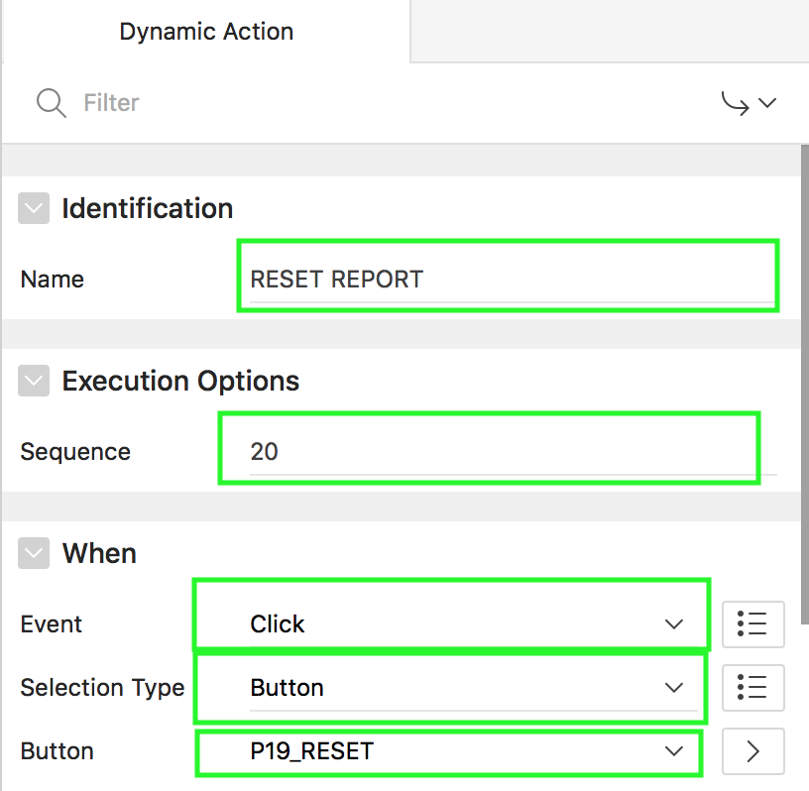
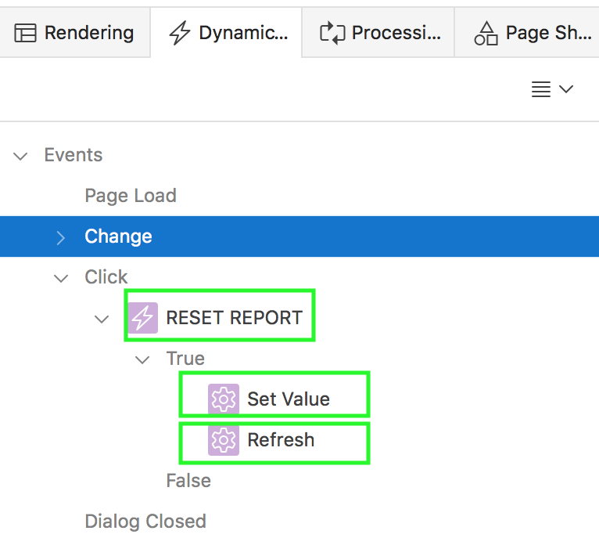
Filtering and Refreshing a Report: Steps
Dynamic Action: RESET REPORT
Notes:
Now, you create the second dynamic action, Reset Report.
Right-click Events and select Create Dynamic Action. The Property Editor displays Dynamic Action attributes.
Specify the following Dynamic Action Attributes:
Name: Enter a name for the dynamic action. In the slide example, enter Reset Report.
Sequence: Specify the sequence as 20
Under When > Event: Specify the event that causes the dynamic action to fire. In the slide example, select Click.
For When > Selection Type: Select the type of page element or construct to be used to trigger the event. In the example, select Button
For Button: Select P<n>_RESET
Now, define the action that to be performed if the event evaluates to True or False.

Slide 17
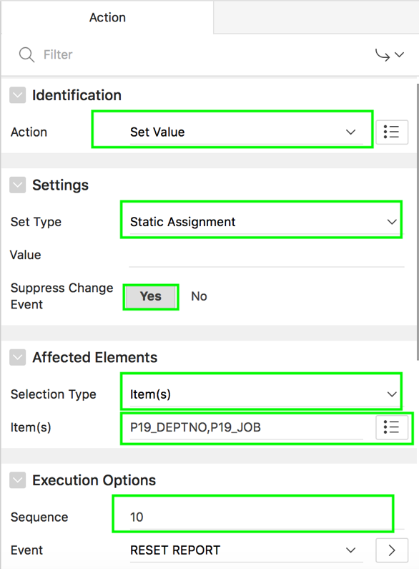
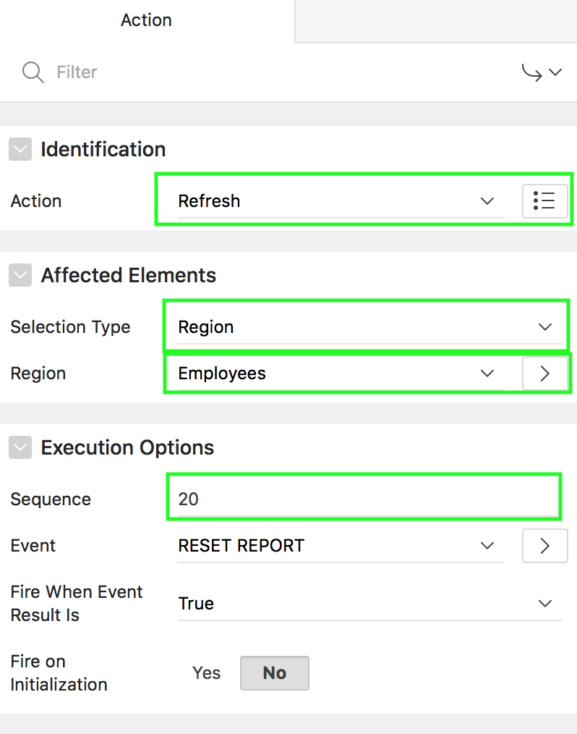

Filtering and Refreshing a Report: Steps
Actions: Set Value, and Refresh
Notes:
Expand the Dynamic Action tree to view the True or False nodes. Under True, select the action that triggers when the condition is true. Edit the action in the Property Editor. For True action, specify the following:
In the slide, select Set Value for Action.
Under Settings, select Static Assignment for Set Type, and select Yes for Suppress Change Event.
Under Affected Elements, select Item(s) for Selection Type. Then, select P<n>_DEPTNO, P<n>_JOB.
Under Execution Options, enter 10 for Sequence
You need to create another True action. Now, right click True and select Create True Action.
In the slide, select Refresh for Action.
Under Affected Elements, select Region for Selection Type. Then, select the report region. In the slide, select Employees for region.
Under Execution Options, enter 20 for Sequence
Click Save and Run Page.

Slide 18
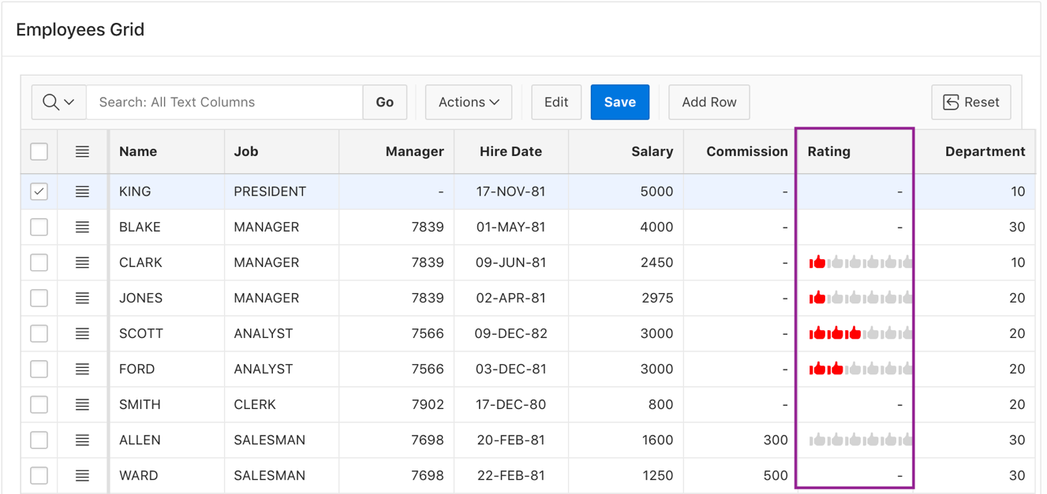
What is a Plug-in?
A plug-in is an extension to the built-in types of Application Express
Use plug-ins for declarative use of new item, region, process and dynamic action types in your application
Example of implementing the Star Rating Plug-In
Notes:
Oracle Application Express supports a set group of authentication scheme, authorization scheme, item, region, dynamic action, and process types. Plug-ins offer a means of augmenting these built-in types by declaratively creating and using new types in your application. Because plug-ins are designed for reuse, developers can export and import them to other workspaces and also share them with the Oracle Application Express Plug-in community by using the Plug-in Repository.
Once defined, plug-in based components are created and maintained very much like standard Application Express components. Plug-ins enable developers to create highly customized components to enhance the functionality, appearance and user friendliness of their applications.
The slide example shows a specified format for the Phone Number. You import the Masked Field [Plug-In] in to your application and then create an item of Masked Field [Plug-In] type on the Customer Details page. In the next few slides, you learn how to import and implement a plug-in in your application.

Slide 19
Implementing a Plug-in in your Application
The process of implementing a plug-in involves:
Create a plug-in or import a plug-in into your application
Review, edit, or create an authorization scheme, item, region, process, or dynamic action type to use the plug-in
Run your application to test the plug-in
Notes:
The slide shows steps involved in the process of implementing a plug-in in your application. Once you create or import a plug-in, you review the plug-in definition and make changes to optimize the use of plug-ins.

Slide 20
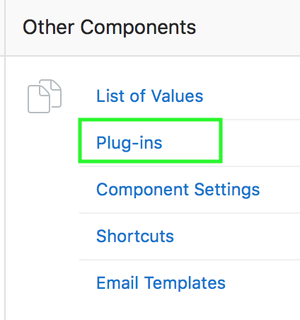
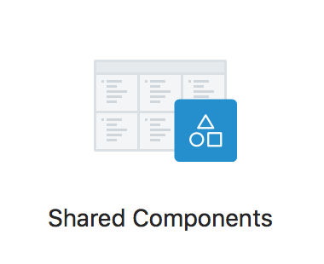
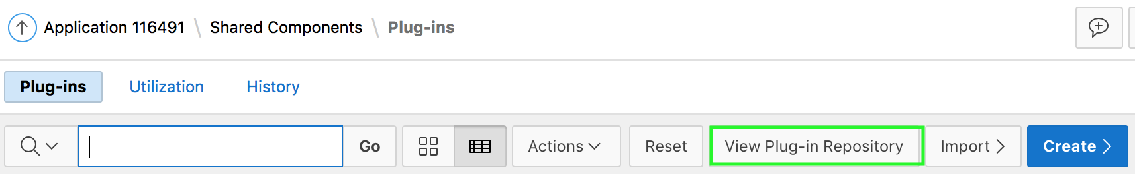
Viewing the Plug-in Repository
https://apex.oracle.com/plugins
Notes:
The Plug-in Repository provides a central location where developers can share and download plug-ins. The repository is located on the Oracle Technology Network.
To view the Plug-in repository, perform the following steps:
Navigate to the Plug-ins page. To access the Plug-ins page, navigate to your application home page. Click Shared Components, and under Other Components select Plug-ins.
Click View Plug-in Repository. The Oracle Application Express Plug-in Repository displays.
In your browser, you can also navigate to the Oracle Application Express Plug-in Repository: https://apex.oracle.com/plugins

Slide 21
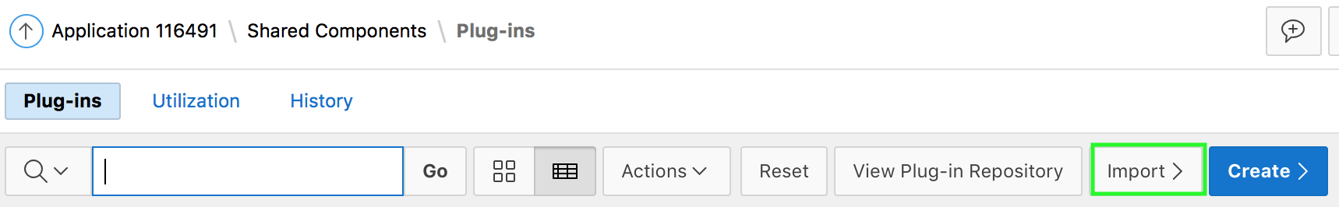
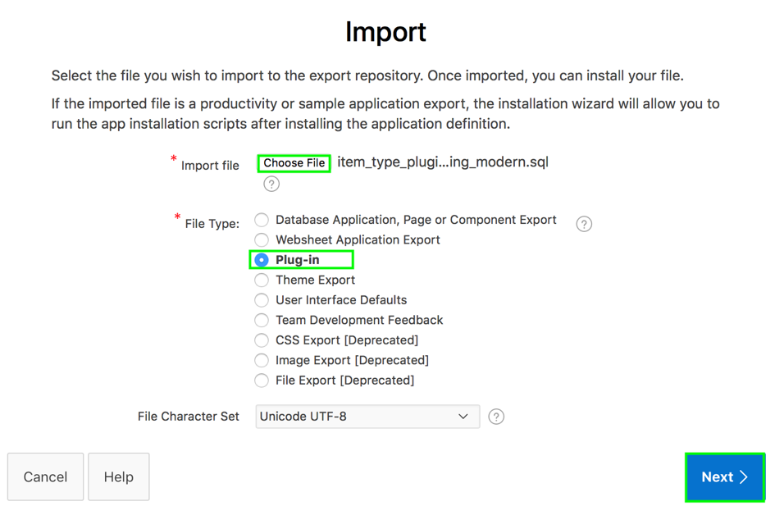
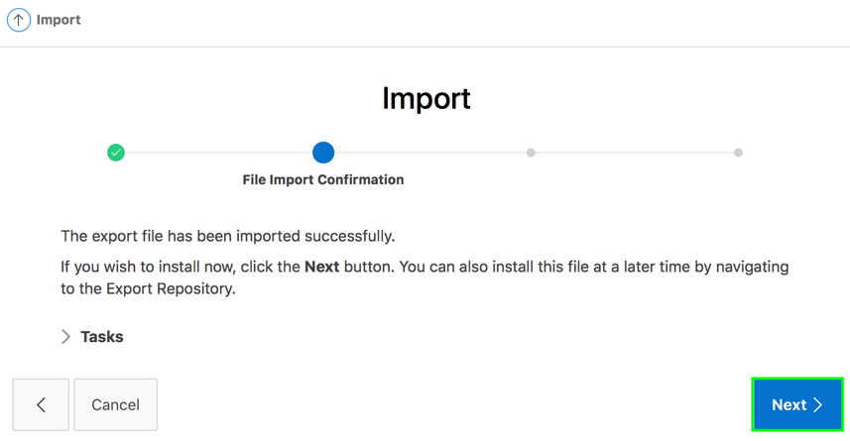
Importing and Installing a Plug-in
Notes:
To implement a plug-in in your application, you need to first import or create it in your application. To import a plug-in to your application, perform the following steps:
Navigate to your application home page and click Shared Components.
Under Other Components, select Plug-ins.
On the Plug-ins page, click Import.
From your local directory, choose the plug-in import file. Notice that the file type is automatically set to Plug-in. Click Next.
The file has been imported successfully. Click Next on the file import confirmation page.

Slide 22
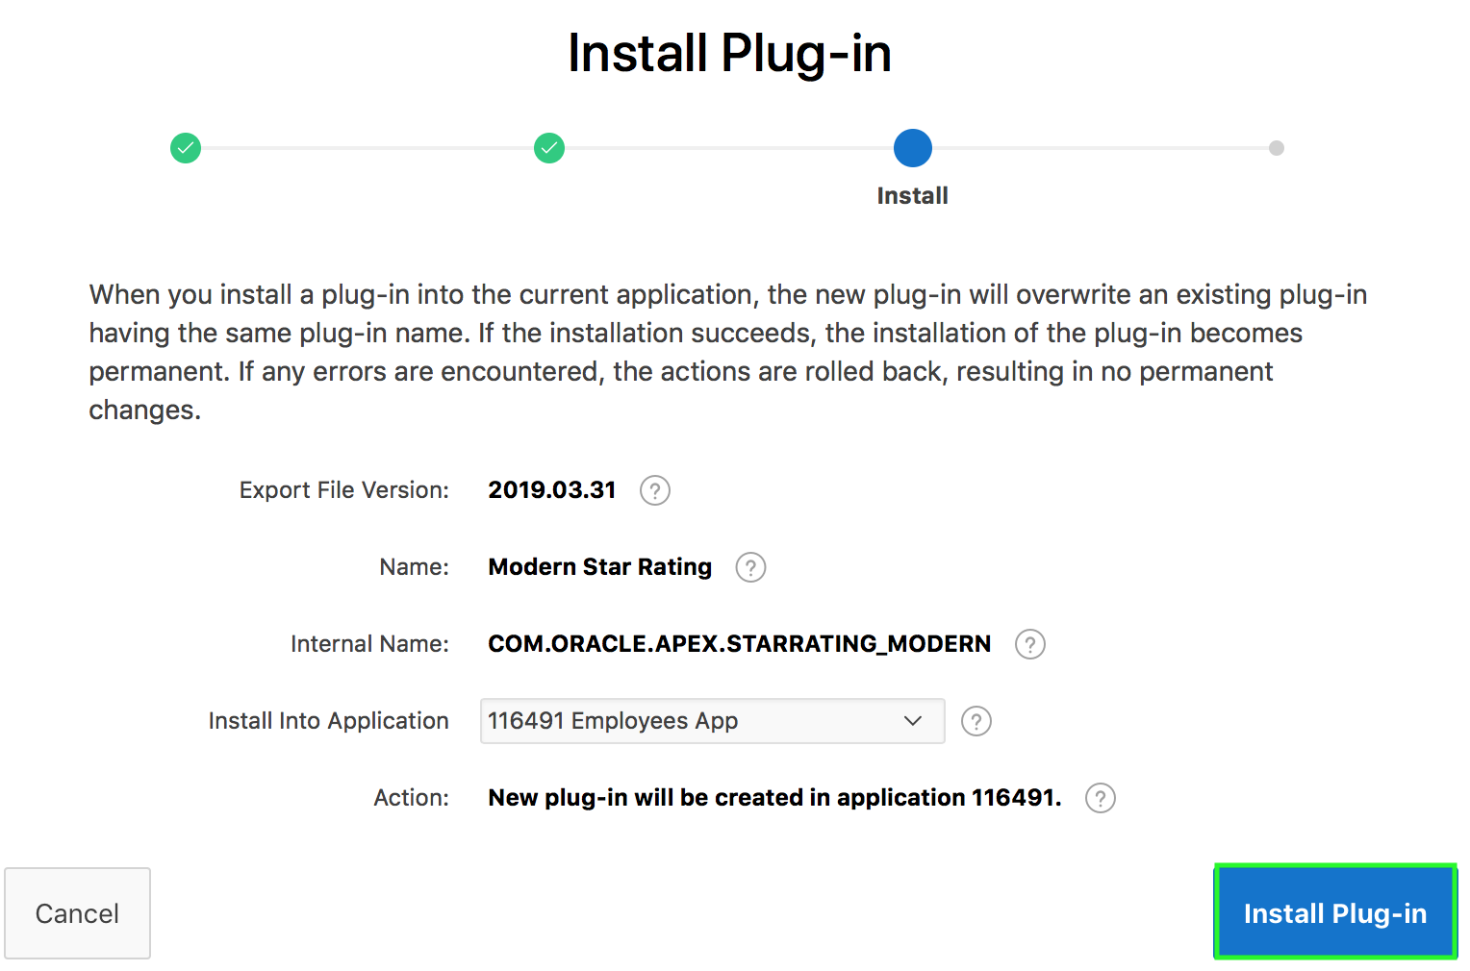
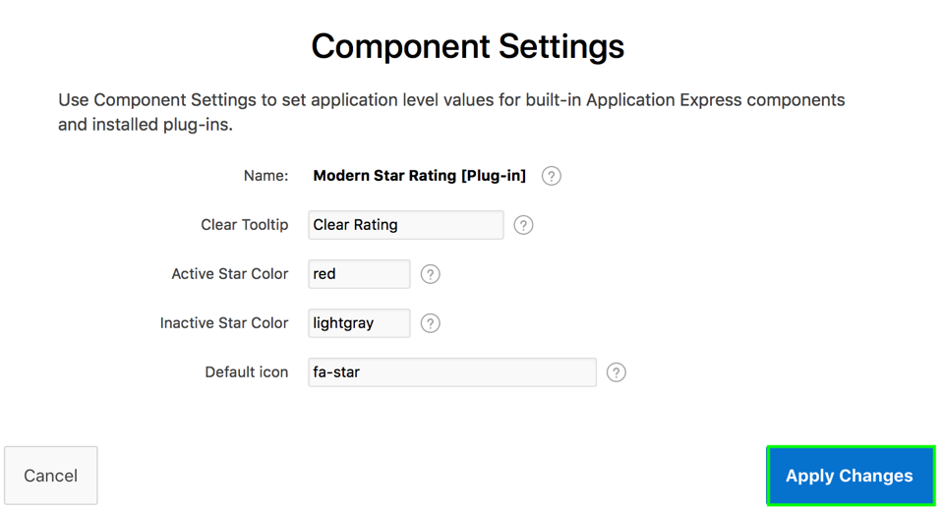
Importing and Installing a Plug-in
Notes:
On the Install page, select the application that you want to install the plug-in into. Then, click Install Plug-in.
On the Component Settings page, click Apply Changes. The Plug-in is installed and is now listed on the Plug-ins page.

Slide 23
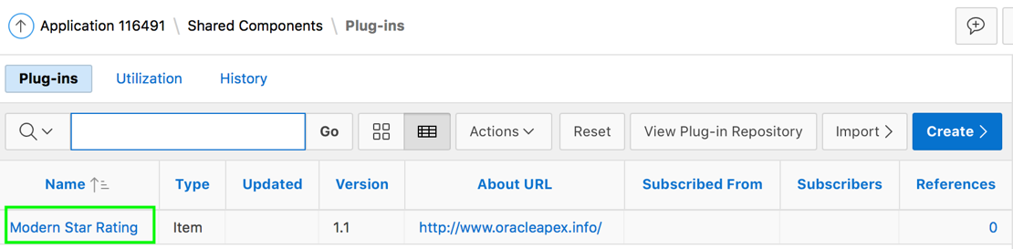
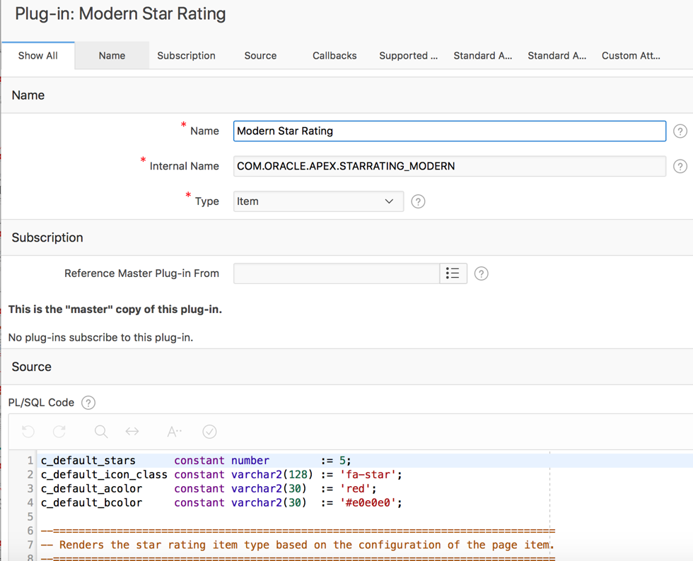
Viewing a Plug-in Definition
Notes:
To review the a plug-in definition, navigate to your application Shared Components. Then, under Other Components, click Plug-ins. On the plug-ins page, under Name, click the plug-in name. You are now navigated to the plug-in definition.

Slide 24
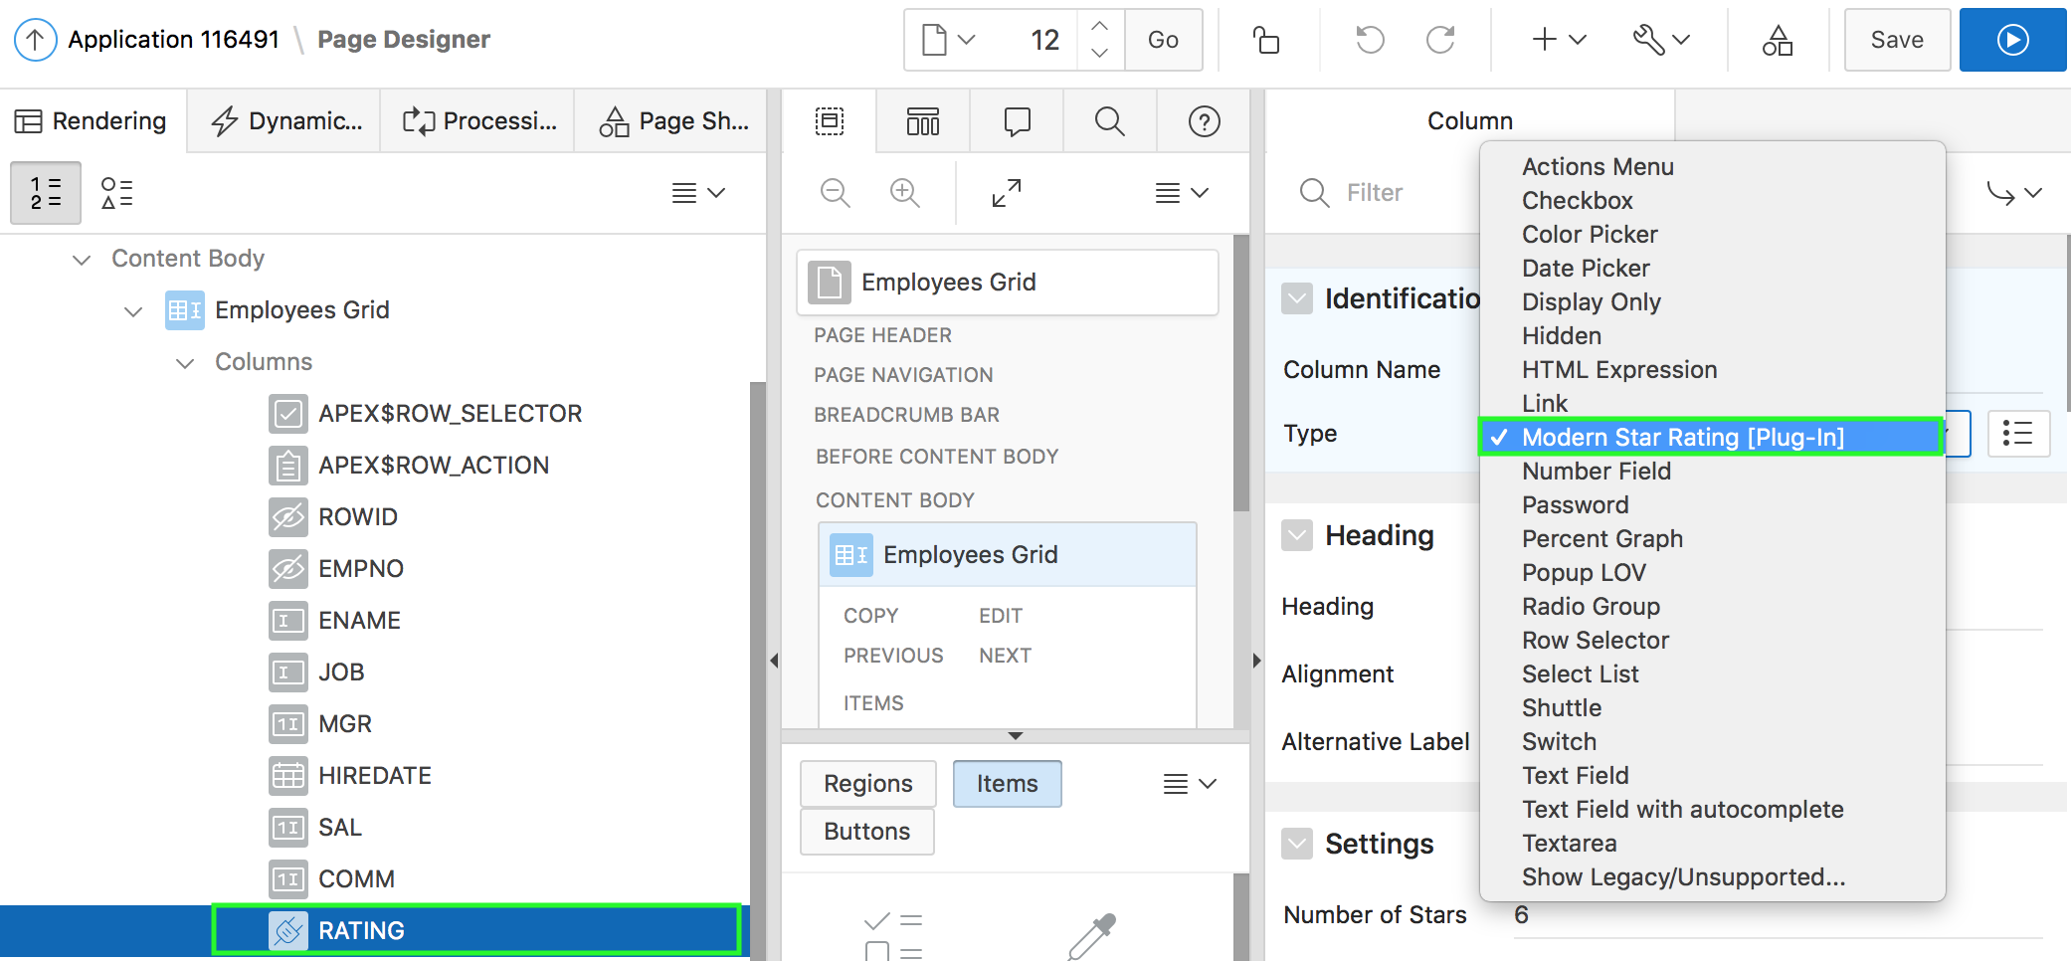
Using the Plug-in in your Application
Select Modern Star Rating [Plug-in] for Identification > Type
Notes:
Now that the plug-in is installed in your application, you can use it. In the slide example, you already created an interactive grid
on the EBA_DEMO_IG_EMP table. This interactive grid includes a RATING column which is a Number Field type. You modify the RATING column type to use the Modern Star Rating [Plug-in] type.
In the slide example, perform the following steps:
View the page in page designer.
Under Rendering, select the Interactive Grid region and expand Columns.
Select RATING
In the Property Editor, under Identification, select Modern Star Rating [Plug-in] type.

Slide 25
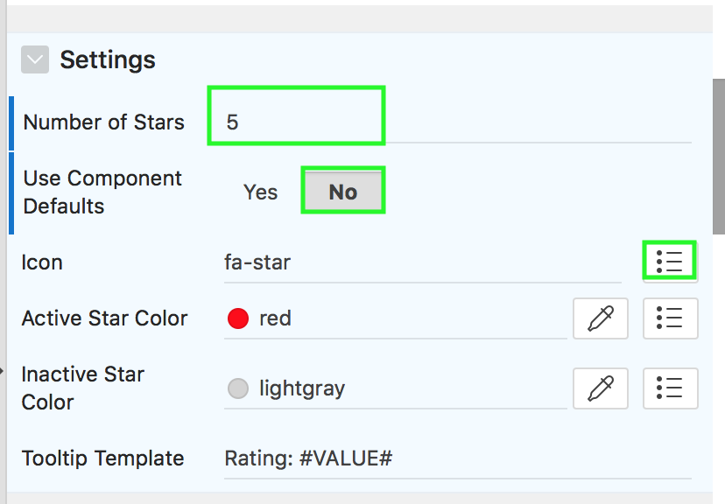
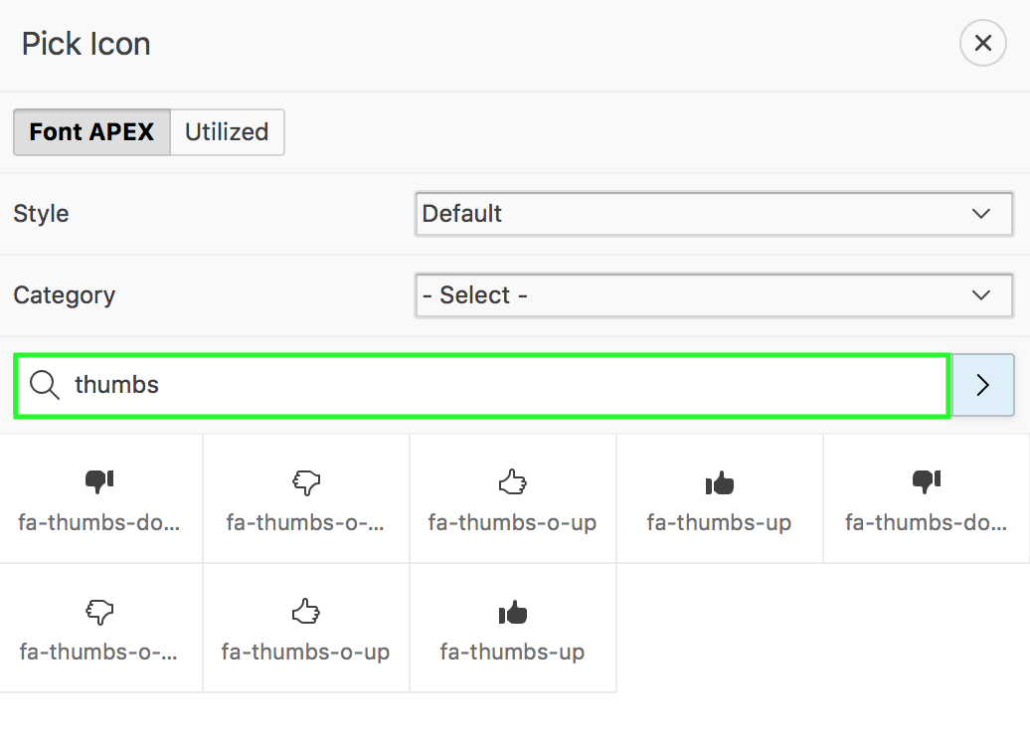
Using the Plug-in in your Application
Notes:
Under Settings, enter the number of stars you want to be displayed. In the slide example, enter 5. You can choose to use the component defaults for the plug-in. In the slide example, you do not want to use the default fa-star icon. Therefore, select No for Use Component Defaults. Click the Icon select list.
The Pick Icon dialog appears. This displays the Font APEX icon library. In the slide example, enter thumbs in the search filed and click Search. Select any of the icons from the filtered result.
Accept the remaining defaults. Click Save and Run Page. In the interactive grid, you can now see the implementation of the Star Rating Plug-in for the Rating column.

Slide 26
Summary
In this lesson, you learned how to :
Create and use Dynamic Actions in your application
Import and install Plug-ins in your application
Implement Plug-ins in your application

Slide 27


Slide 28
Hands-on Lab

